Slide 1
DAVİD EAGLEMAN
Neuroscientist
Mert Eren Doğançay 10E - 505

Slide 2
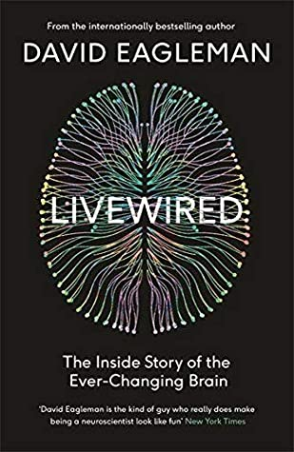
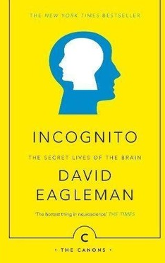
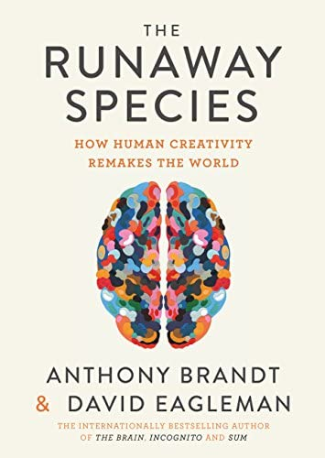
who is David Eagleman?
David Eagleman is studying neuroscience at Stanford University.
Time perception, vision, synesthesia and the intersection of neuroscience with the legal system are the main issues that Dr. Eagleman is working on.
Published in Atlantic, The New York Times, Wired, and New Scientist, Dr. Eagleman, Wednesday is Indigo Blue and the neuroscience books Incognito – The Secret Life of the Brain and the Brain – Your Story, also translated into Turkish, as well as the international bestseller, which was translated into 28 languages, including Turkish, selected as the Best Book of the Year by Barnes and Noble, New Scientist and Chicago Tribune. He is also the author of the book And Forty Stories from Next Life.

Slide 3
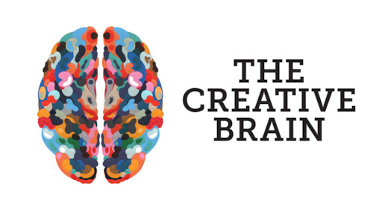
The Creative Brain
Neurologist David Eagleman leverages the creative processes of various inventors as he searches for inconceivable and risky ways to increase creativity.

Slide 4
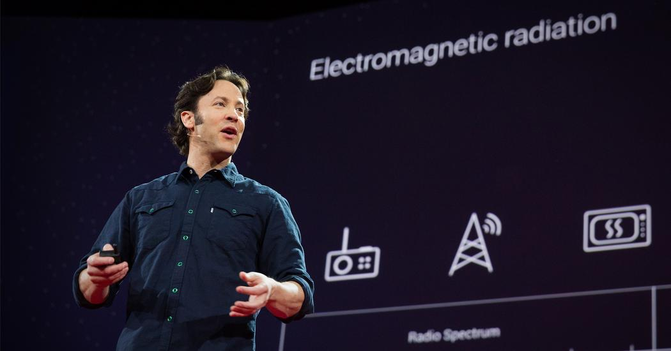
David Eagleman often gives people information about the brain and its work on TED and similar platforms

Slide 5
David Eagleman states the following on electromagnetic radiation in a ted talk: Instead, we are confined to this very narrow slice of perception, right in the middle. Even weirder, we can't see many events that take place even in the slice of reality we call home. Let's take the colors in our world. These are light waves, electromagnetic radiations, that bounce off objects and hit special receptors behind our eyes. But we can't see all the waves here. What we're actually seeing is less than a 10 trillionth of what's here. Radio waves, microwaves, X-rays and gamma rays are passing through your body right now and you have no idea; because you weren't born with the biological receptors needed to see them. There are thousands of phone calls going through your body right now and you don't notice any of them.

Slide 6
David eagleman talks about their General Network experiment at the Lab:
So here's an experiment we're doing in the lab. A subject is feeling a real-time streaming feed from the Net of data for five seconds. Then, two buttons appear, and he has to make a choice. He doesn't know what's going on. He makes a choice, and he gets feedback after one second. Now, here's the thing: The subject has no idea what all the patterns mean, but we're seeing if he gets better at figuring out which button to press. He doesn't know that what we're feeding is real-time data from the stock market, and he's making buy and sell decisions. And the feedback is telling him whether he did the right thing or not. And what we're seeing is, can we expand the human umwelt so that he comes to have, after several weeks, a direct perceptual experience of the economic movements of the planet. So we'll report on that later to see how well this goes.

Slide 7
